Slide 1
PURITY TEST OF ALCOHOL
Prepared By
DR.RAMYA S.S
Asst.Prof., Dept of Pharmacy

Slide 2
ETHYL ALCOHOL
Is a liquid vehicle used in Homoeopathy for preparation of Homoeopathic Medicine
Chemical Formula - C₂H₅OH
Sources – Molasses, Sugar, Starch, Ethylene
Common impurity – Fusel oil which is iso-amyl alcohol and is formed when alcohol is formed from starch.
Other impurities – Acid, Water, Methyl alcohol, glycerine, Butyl alcohol

Slide 3
AIM – To determine the impurities in the given sample of ethyl alcohol
Materials Required – Blue Litmus Paper, Silver nitrate solution, Conc. Sulphuric acid, Anhydrous copper sulphate, Salicylic acid, Spirit lamp, Test tubes

Slide 4
PROCEDURE
EXPERIMENT | OBSERVATION | INFERENCE
TEST FOR ACID The given sample of alcohol is taken in a test tube and a blue litmus paper is dipped into it | Blue litmus paper changed to red colour | Presence of acid
TEST FOR ACID The given sample of alcohol is taken in a test tube and a blue litmus paper is dipped into it | No change in colour of Blue litmus paper | Absence of Acid

Slide 5
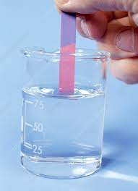
TEST FOR ACID

Slide 6
TEST FOR OTHER IMPURITIES
EXPERIMENT | OBSERVATION | INFERENCE
The given sample of alcohol is taken in a test tube and an equal volume of distilled water is added and smell it | A foreign smell is found | Impure alcohol
The given sample of alcohol is taken in a test tube and an equal volume of distilled water is added and smell it | Characteristic smell of alcohol is found | Pure alcohol

Slide 7
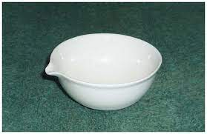
Porcelain Dish

Slide 8
TEST FOR FUSEL OIL
EXPERIMENT | OBSERVATION | INFERENCE
Equal amount of Conc.Sulphuric acid and given sample of ethyl alcohol is taken in a test tube | A Reddish sediment is formed | Presence of Fusel oil
Equal amount of Conc.Sulphuric acid and given sample of ethyl alcohol is taken in a test tube | No Reddish sediment is formed | Absence of Fusel oil

Slide 9
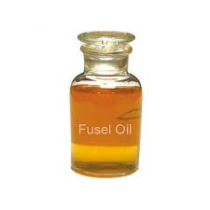

Slide 10
TEST FOR FUSEL OIL
EXPERIMENT | OBSERVATION | INFERENCE
Take a test tube and pour 2-3 ml of the given sample of alcohol and add few drops of Silver nitrate solution into it and expose the test tube to Sunlight | A Reddish sediment is formed | Presence of Fusel oil
Take a test tube and pour 2-3 ml of the given sample of alcohol and add few drops of Silver nitrate solution into it and expose the test tube to Sunlight | No Reddish sediment is formed | Absence of Fusel oil

Slide 11
TEST FOR FUSEL OIL
EXPERIMENT | OBSERVATION | INFERENCE
Small amount of the given sample of alcohol is poured into a porcelain dish and allowed to evaporate spontaneously protected from dust. Then smell the dish | An acrid smell is found | Presence of Fusel oil
Small amount of the given sample of alcohol is poured into a porcelain dish and allowed to evaporate spontaneously protected from dust. Then smell the dish | Characteristic smell of alcohol is found | Absence of Fusel oil

Slide 12
TEST FOR WATER
EXPERIMENT | OBSERVATION | INFERENCE
Take a test tube and pour 2-3 ml of the given sample of alcohol into it and add 0.5 g of anhydrous copper sulphate | The colour of the powder turns to blue | Presence of Water
Take a test tube and pour 2-3 ml of the given sample of alcohol into it and add 0.5 g of anhydrous copper sulphate | The colour of the powder remains the same | Absence of Water

Slide 13
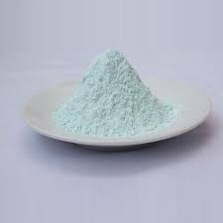
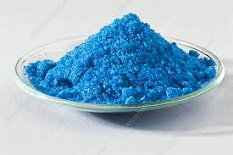
TEST FOR WATER
Anhydrous copper sulphate
Hydrated Copper sulphate

Slide 14
TEST FOR METHYL ALCOHOL
EXPERIMENT | OBSERVATION | INFERENCE
Take a test tube and pour 2-3 ml of the given sample of alcohol into it and add 1 g of Salicylic acid and 1 ml of Conc.Sulphuric acid into it. Then hold the test tube over a spirit lamp flame and warm it and then smell the test tube | A fragrant smell of methyl salicylate ( Oil of Wintergreen) is obtained If only smell of alcohol | Presence of Methyl alcohol Absence of Methyl alcohol

Slide 15
